Slide 1


How to get designers involved?
Jan-Christoph Borchardt @jancborchardt

Slide 2

opensourcedesign.net
/jobs

Slide 3
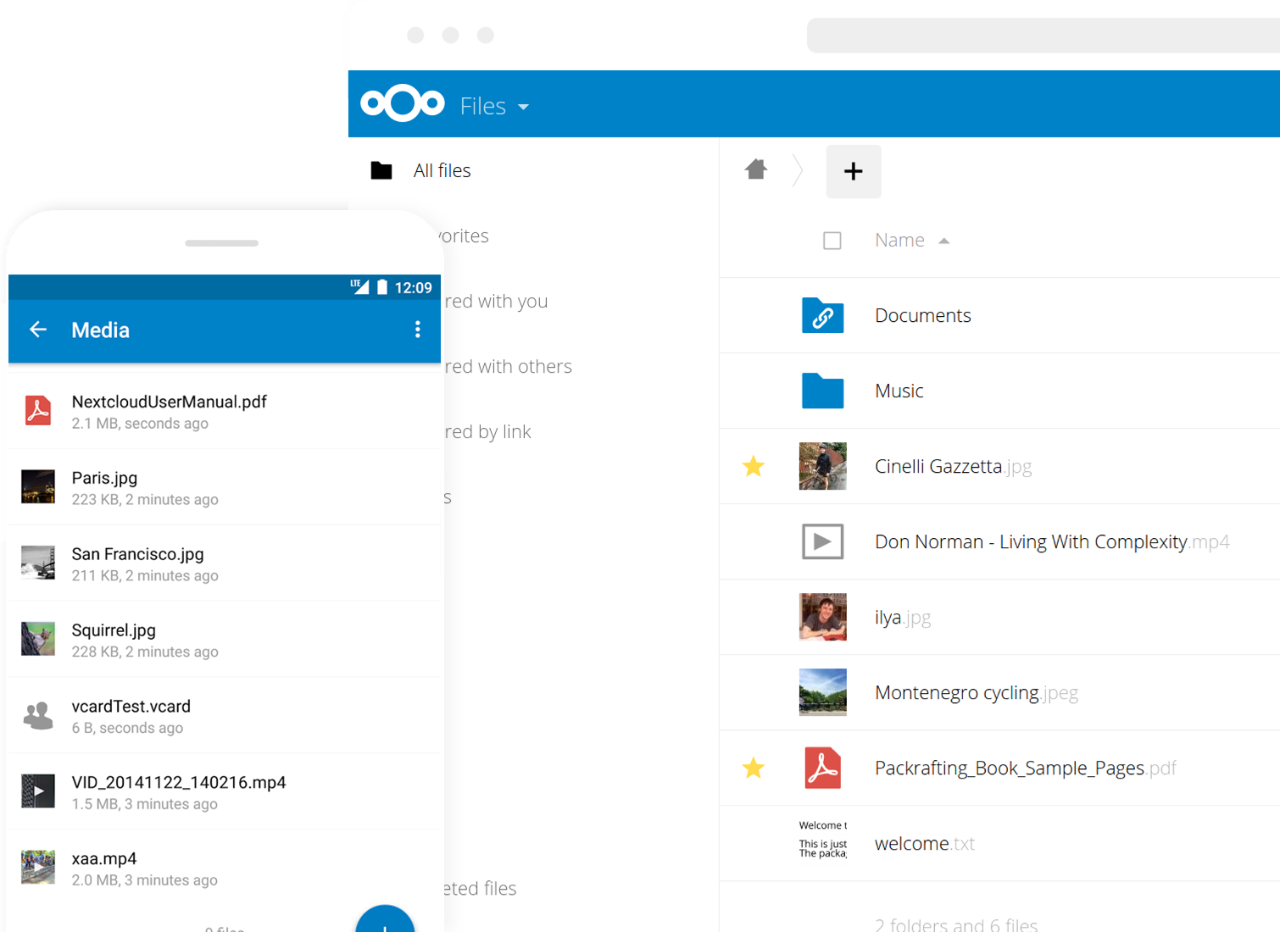
Nextcloud

Slide 4
1.
Culture of design

Slide 5
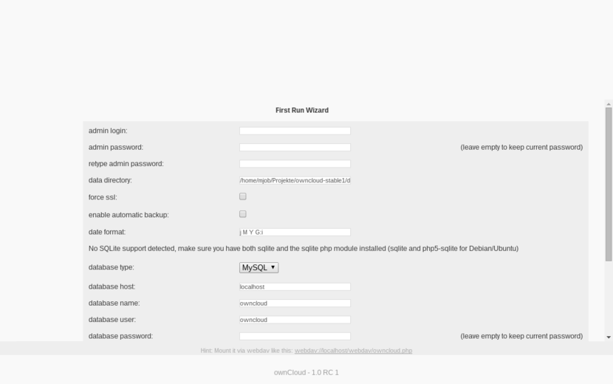
Installation

Slide 6
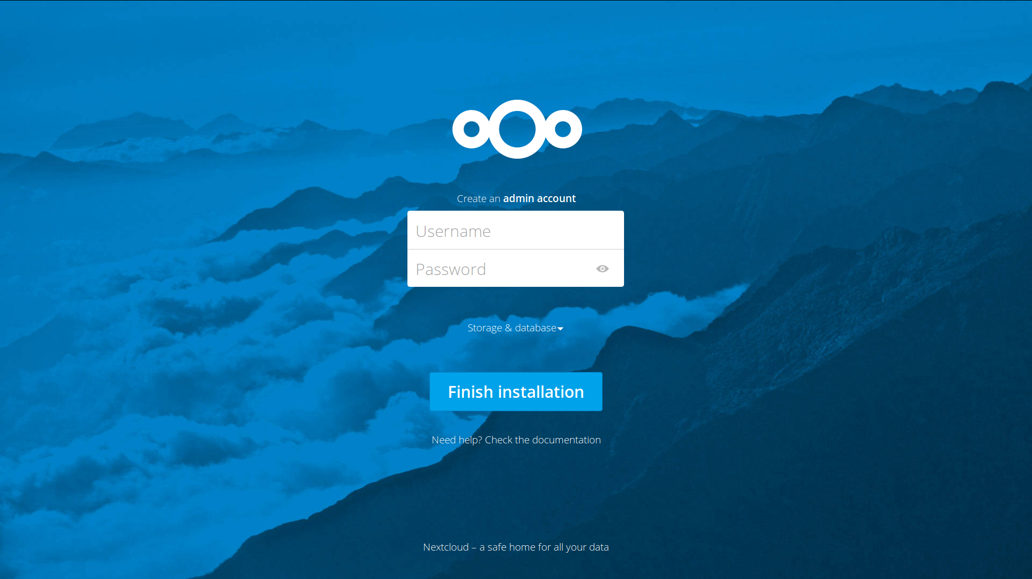

Slide 7
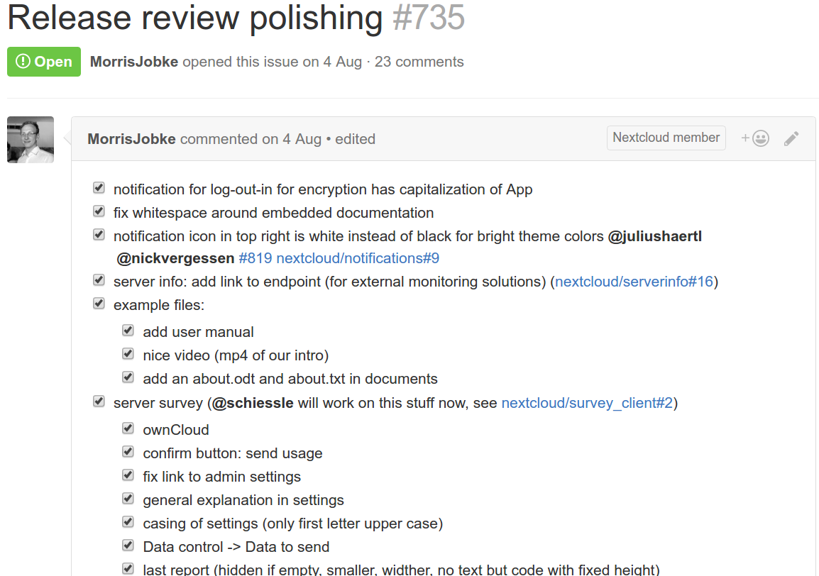
Care about details

Slide 8
2.
Be informative

Slide 9
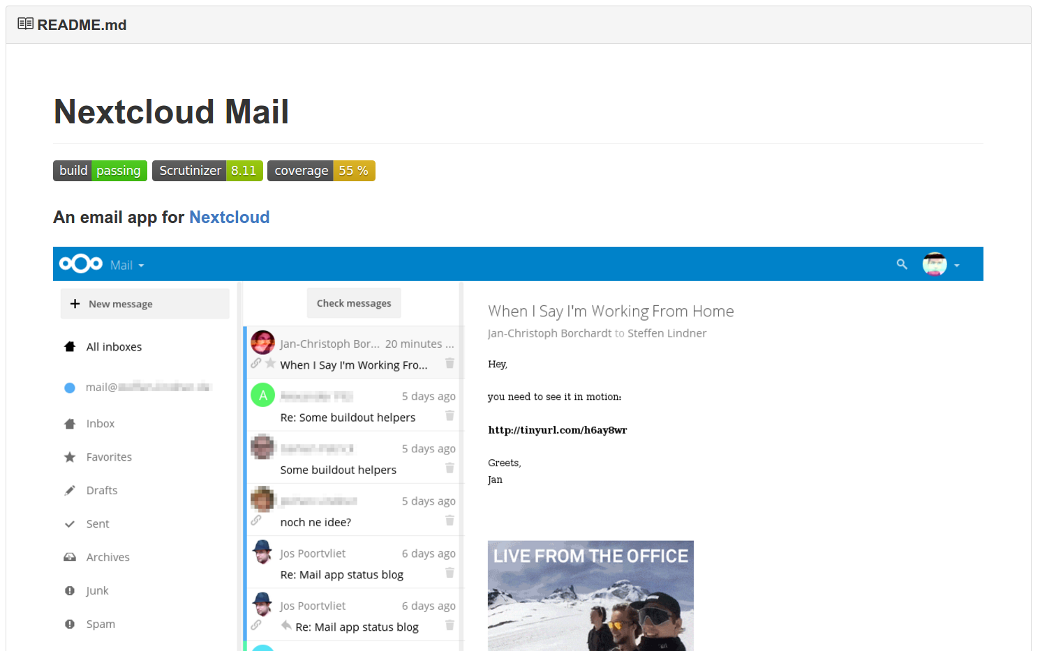
Show screenshots

Slide 10
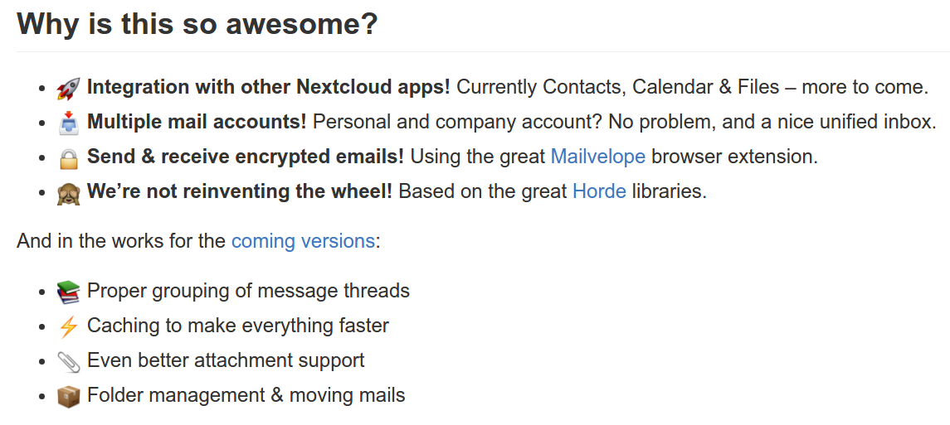
Concise feature list

Slide 11
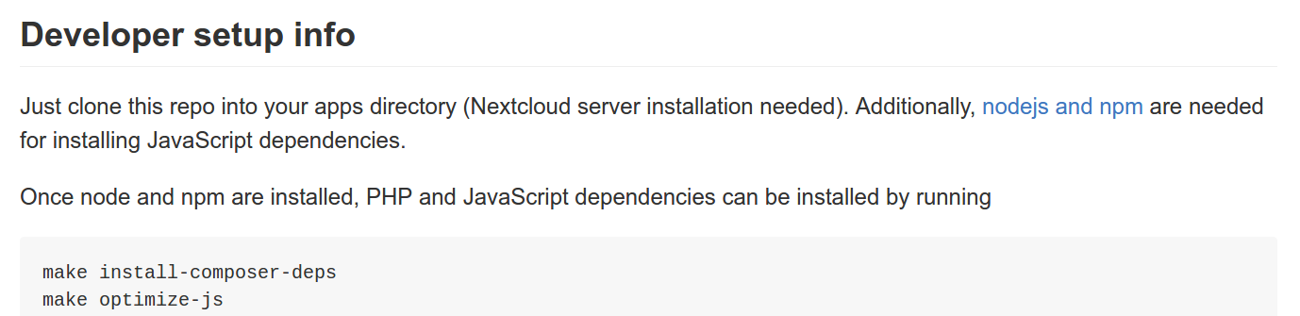
How to set it up?

Slide 12
3.
Be welcoming

Slide 13
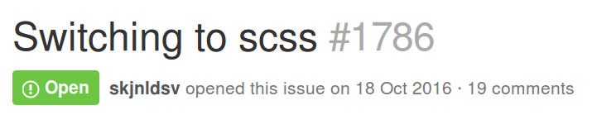
Remove barriers to entry
design

Slide 14
Issue tags
design
starter issue

Slide 15
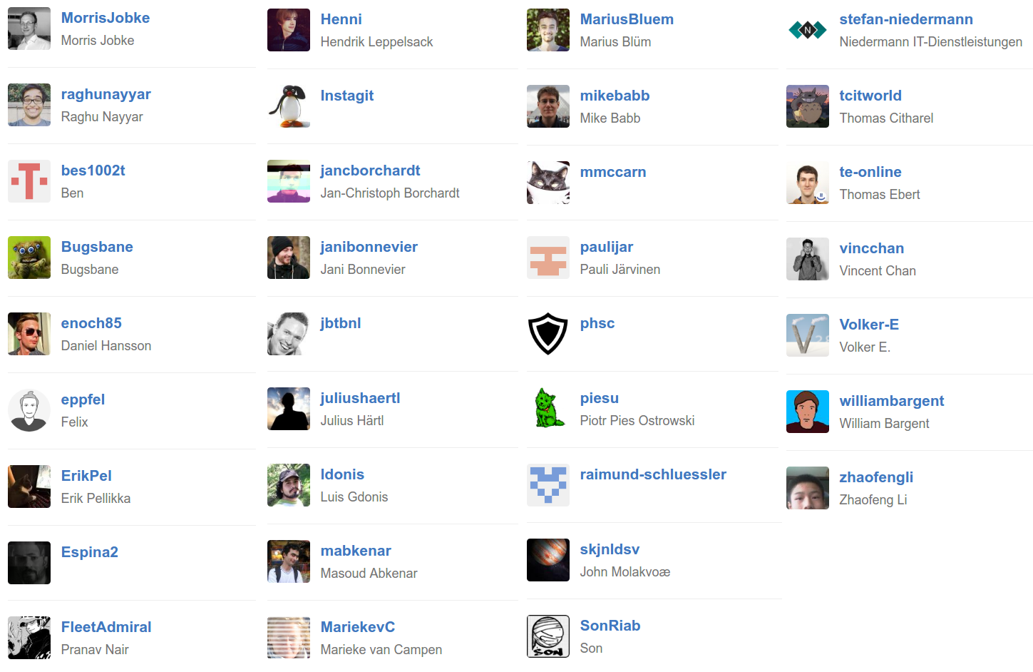
Design team
@nextcloud/designers

Slide 16
4.
Talk about design!

Slide 17
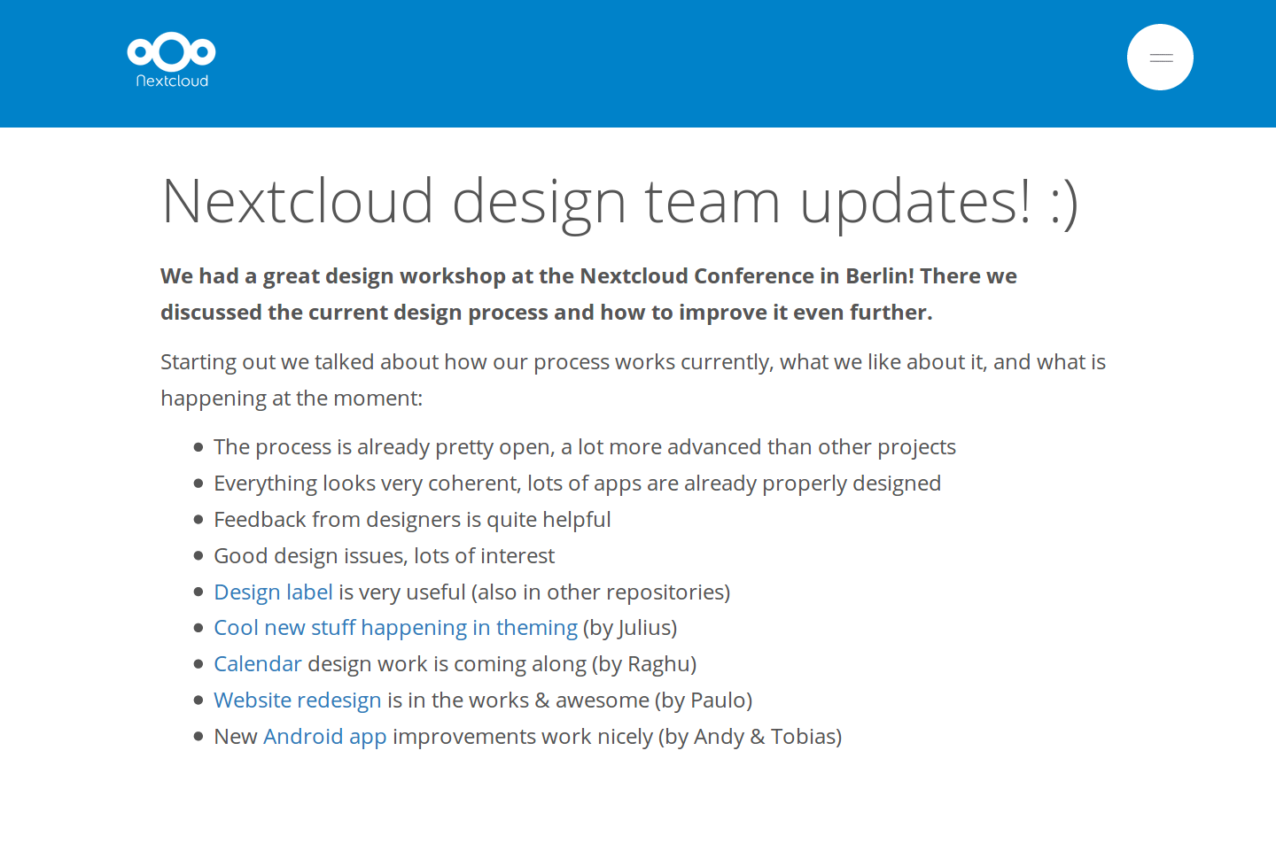
Publish updates

Slide 18
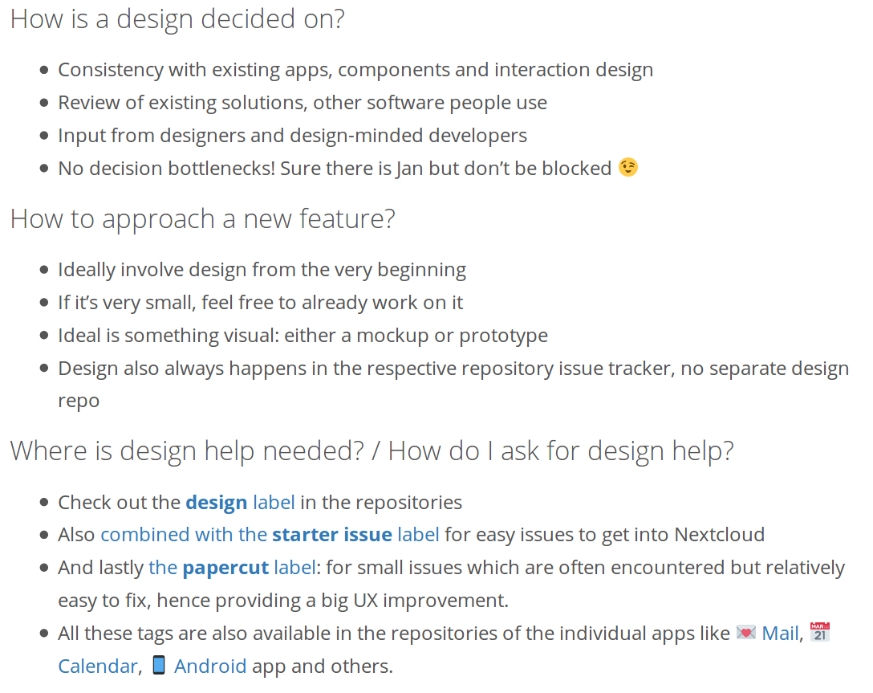
Address questions

Slide 19
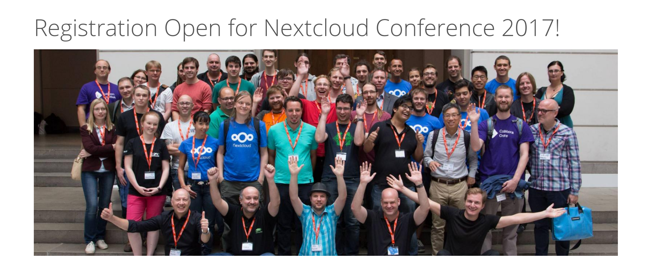
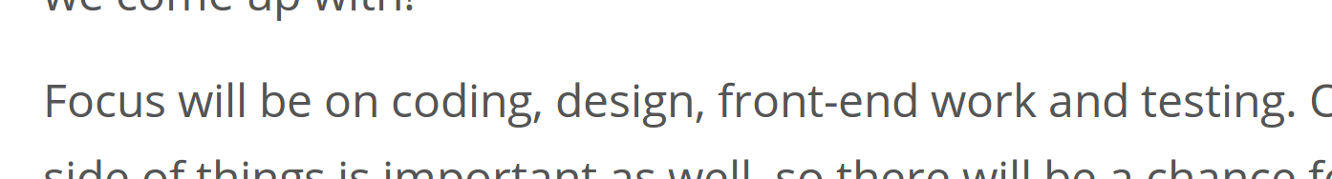

Slide 20
1. Culture of design
2. Be informative
3. Be welcoming
4. Talk about design

Slide 21
nextcloud.com
/contribute
Feedback ❤️️ submission.fosdem.org/feedback/5595.php
Jan-Christoph Borchardt @jancborchardt

